Slide 1


WhatsApp Business School
Discover the right Information you need to move your business to the next level.
affiliated with E-Connect TechMedia
WhatsApp Business School: – hidden tools, software, information and systematic facts that will fetch you 6 digits monthly.

Slide 2
Table of Content
Introduction / About
Why WhatsApp Business?
Course Outline
Other Things You Will Learn
Course Summary
What You Need To Know: matric number, certificate, working with us
A Little Story
WhatsApp Business Vest
Meet The Course Lecturers
Taking Action
WhatsApp Business School: – hidden tools, software, information and systematic facts that will fetch you 6 digits monthly.

Slide 3
Introduction / About
WhatsApp Business School is an online institution that is established for business owners and anyone willing to go into business in this information age.
Our vision and mission is to equip youths and business owners with the necessary skills and information they need to make more sales in their business. WhatsApp Business School is centered towards reducing the number of poverty in the society.
Any business that will survive must market. Gone are the days when people go from street to street to advertise their goods and services. In this new age, one can stay in the comfort of the room and make a lot of sales in a day than going around to advertise their products and services. This course teaches both WhatsApp and Facebook marketing and in addition some tools that makes making money on WhatsApp possible even when you don’t have a business yet.
This course is set to reveal you to the right information you need for your financial salvation. If you are a student, you don’t have to call home every time you need money. If you are already working, these secrets will teach you to almost double your income in a short while.
WhatsApp Business School: – hidden tools, software, information and systematic facts that will fetch you 6 digits monthly.

Slide 4
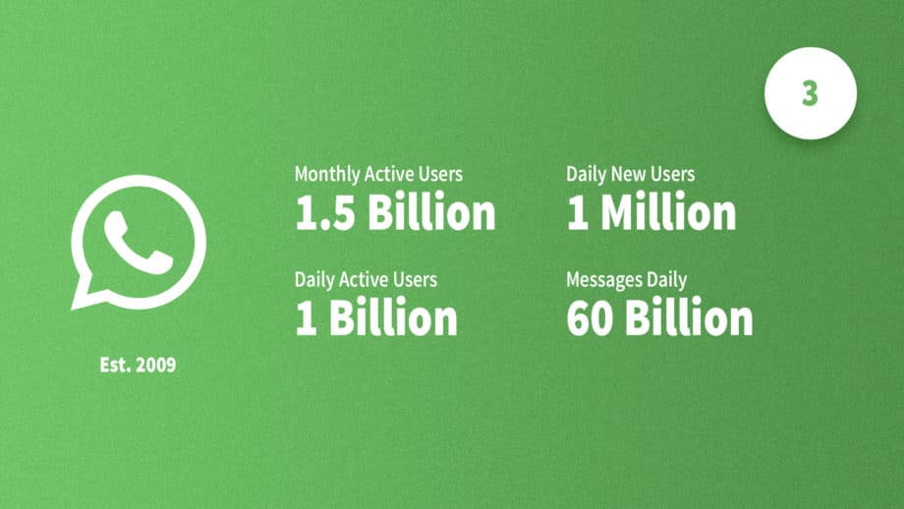



Why WhatsApp Business?
WhatsApp has an active monthly user of 1.5 Billion and an active daily user of 1 Billion. 1 Million people join everyday and 60 Billion messages are sent daily. What does this statistics tell you? There are people on WhatsApp – the most popularly used messaging app. Business can only thrive wherever people are! Without people, you can’t make money; even if you are a fraudster, you need people to scam not to mention when your business is legal and legit.
The truth is that if you really leverage on WhatsApp using the skills this course wants to teach you, you can’t imagine the result you will get.
WhatsApp is owned by Facebook. What does this tell you? Facebook and WhatsApp controls the largest audience. Wherever people are, there money is. WABS will teach you the secret to make it big using WhatsApp and Facebook only.
WhatsApp Business School: – hidden tools, software, information and systematic facts that will fetch you 6 digits monthly.

Slide 5
Course Outline
Course Code Course Title Course Unit
WAB 101: Overview of WhatsApp, WA Web and WA Business [1 unit]
WAB 102: WhatsApp Bots [2 units]
WAB 201: E-Commerce store [2 units]
WAB 202: Facebook Advertisement (I) [1 unit]
WAB 301: Facebook Advertisement (II) [2 units]
WAB 302: Monetizing WhatsApp [1 unit]
WAB 401: Making Money Immediately [1 unit]
WAB 402: Saving/Investing for the future [1 unit]
Summary: WA + FB + Bot + Other tools + Hidden Secret = MONEY [11 units]
WhatsApp Business School: – hidden tools, software, information and systematic facts that will fetch you 6 digits monthly.

Slide 6
Other Things You Will Learn
The main course package will teach you WhatsApp Marketing fully – how you can sell anything to anyone anywhere and will also introduce you to Facebook Marketing.
In addition, you will learn how to set up a WhatsApp bot and how to use it for the advantage of your business.
This new skill will teach you how to run advert of your own without paying status TVs or blogs. You will learn to drive traffic to any link of your choice and make money from it.
You do not have to pay for advert each time you have something to sell; this WhatsApp Business Master Course will show you how to create your own targeted list/audience that you can market to whenever you have anything to sell.
You will be introduced to WhatsApp Information Business (WIB) where even if you don’t have anything you sell, you can base your business on information. Yes! There is money in information, and you will get to know how to leverage on information to make a lot of income.
BONUS: You will learn a secret system that will generate money and more money for you even when you are asleep.
WhatsApp Business School: – hidden tools, software, information and systematic facts that will fetch you 6 digits monthly.

Slide 7
Course Summary
Description Value
Total number of courses: 8
Total outlines/sub-topic: 28
Total units: 11
Total duration (weeks): 2
Total duration (days): 8
Total duration (hours): 11
Days involved in the week: Sunday, Tuesday, Thursday, Saturday
WhatsApp Business School: – hidden tools, software, information and systematic facts that will fetch you 6 digits monthly.

Slide 8
What You Need To Know
You will be given a matric number. Your matric number is the unique code that identifies you from others. If after the training, you decide to work with us, your matric number will be needed to save your record on our database. It helps us identify you quickly and respond to you faster, because your contact will be saved with your matric number and you’ll get faster response to messages than a non WABS student.
The format for the matric number is WAB, Year, Batch, Candidate number. E.g. WAB19A001
Where WAB is the course code, 19 is the year, A is the batch and 001 is your own number.
You will receive a certificate from WhatsApp Business School and E-Connect TechMedia at the end of the training. This certificate is N500 only (printable PDF), and it is optional for you to get.
At the end of this training, you can start working with us and we will pay you for it.
Tuition fee for WABS is N5,000 only and we promise you maximum value for your money.
WhatsApp Business School: – hidden tools, software, information and systematic facts that will fetch you 6 digits monthly.

Slide 9
A Little Story
Years ago when I was younger than this, I used to check Google for How to make money online. The things I would see there were relating to having a website, doing email marketing and so many others. I consumed a lot of data, but I wasn’t really making any money online until I discovered some secrets in 2016 (note that discovering is different from utilizing). Two years later (2018), I discovered some other secrets, but I started making use of them in the later part of 2018. Earlier in 2019, I discovered something else, and that is what I’m about to share with you in this course.
I did not make use of the things I discovered in 2016; those I know that made use of those secrets then are in big money today. Now I have to start is again. What a big regret! In order not to have another regret, I started making use of the things I discovered this year almost immediately I found out, and I know what I’ve gotten from it so far; that is why I found them worthy of sharing. If I’ve not tried it, I wouldn’t introduce it to you.
So what I’m saying is that you can have a knowledge of how some things work but if you are not practicing it, you won’t get result. Don’t be like me who started late. Start taking action now!
Now back to my online search on making money, even though I discovered those secrets online, I had to pay for premium courses, like this. The truth is that you will never get something of value for free. You have to pay!
WhatsApp Business School: – hidden tools, software, information and systematic facts that will fetch you 6 digits monthly.

Slide 10
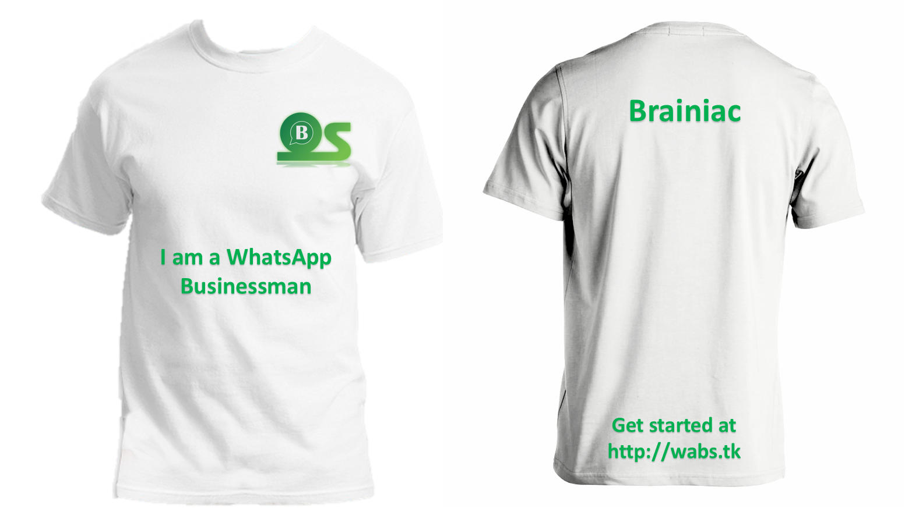
WhatsApp Business Vest
When you make your first or next ₦200,000 – ₦500,000 using the secrets you are going to learn in this course, you will be given a customized WhatsApp Business vest to certify that you have become a true WhatsApp Businessman or businesswoman and we will then welcome you to the family. Cool?
Nickname
WhatsApp Business School: – hidden tools, software, information and systematic facts that will fetch you 6 digits monthly.

Slide 11
Meet The Course Lecturers
During the course of this 2 weeks practical training, two people will be your instructor, lecturers and mentor. They will guide and mentor you, and see that you are able to make use of this new skill to make it big in any niche you decide to function in.
Brainiac: As his name implies, there are lots of work going on in his brain, and he his going to set apart 2 weeks from his busy schedule to patiently attend to, teach and train you. He is the founder of WABS; and he is going to be your main coach, and senior lecturer in this course.
Robot: If you are a student of Adekunle Ajasin University, then I bet you already know who Robot is. He works as the PRO of E-Connect, and a highly intelligent person. He will also make time out of his very busy schedule to attend to you this 2 weeks. He will support and assist Brainiac to coach you during the course of this training. He is a co-founder of WABS.
WhatsApp Business School: – hidden tools, software, information and systematic facts that will fetch you 6 digits monthly.

Slide 12
Taking Action
You will not be pampered, persuaded or forced to enroll for this course. Actually, the lesser the people who knows about this, the better for us who already knew about it; because by teaching or introducing you to this system, we are actually creating competition for ourselves.
The result you will get from this is enough to establish you for life if only you know how to play your game very well. No one gets rich, successful or influential by luck. You have to be intentional about it.
If you will be one of the few people that will be intentional about this, and passionate about getting result, then visit the link below to enroll for this course.
The tuition fee is ₦5,000 only!
Get started here ➔ https://bit.ly/wabsReg
For further enquires, message us on WhatsApp via 08130467826
WhatsApp Business School: – hidden tools, software, information and systematic facts that will fetch you 6 digits monthly.

